Slide 1
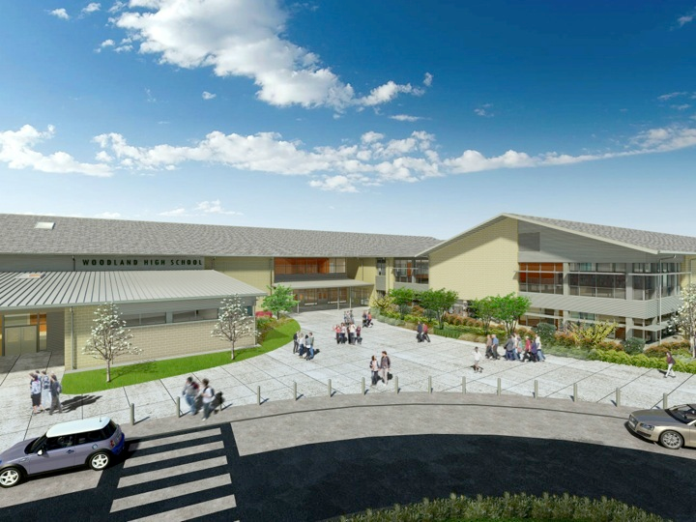
Woodland Public Schools
Facilities and Safety Report
November 2017

Slide 2
Holiday Shutdown Planning In addition to our standard annual cleaning activities, maintenance, custodial, grounds and contractors will be completing the following work. Below is a brief summary and schedule of these items.
FACILITIES REPORT
Storm Drains and Drywells, 12/21 - Clean out storm drains at 3 schools, clear drywell between WPS and WMS, locate and clean drywell by business office.
Replenish EWF, WPS and WIS (schedule pending delivery availability) – Add Engineered Wood Fibers to WIS, WPS main and alternate playground areas to meet fall protection standards
Locks WMS (schedule pending availability) – Start blanking exterior doors and change exterior keys at WMS to enhance school security
HEPA install Ceramics lab – Installation of two Fan Filter Units (FFU’s) to reduce ceramic particulate in classroom environment and create a healthier environment
Annual SWCAA boiler testing 12/26 – Complete annual stack testing and annual Southwest Clean Air Agency compliance inspections and reports
Resurface Green Gym floor 12/20–12/23 Install new water based finish coat to gym floor
Electrical repairs 12/18 -12/22 Install permanent conduit where extension cords have been used, wire in new FFU’s WHS, and miscellaneous other electrical jobs to support other repairs and shutdown activities
House tear down 2280 Lewis River Rd 12/18 –12/23 Demo house next to WIS, clear site of vegetation, grade site, remove fences and lay crushed rock.

Slide 3
Facilities Report Continued
Cameras WPS/WMS 12/18 – 12/29 Complete balance of Exterior cameras WIS, Repair 3 cameras WMS
Chair rail wall WHS (in progress) -Repair area where chairs have been stored, install chair rail to protect newly repaired surface
CNC to WHS (in progress)– Move Mazak CNC (Computer Numerical Control) milling tool to WHS auto shop, relocate existing lathe, milling tool and tire balancer to accommodate new tool install.
Wall and ceiling repairs WMS, WHS (In progress) -Ceiling green hall (2), bathroom and room 430. Stage area WHS
Kitchen items – 12/18 – 12/29 Repair wall WPS, maintenance on freezer WMS and hot line repair WHS
Annual department training 12/19 – OSHA occupational safety training for entire team, ladder, roof, hazcomm, etc.
Installation of weather stations WHS, WMS to support Emergency planning activities
Install remote communication box WHS stadium to support remote operation of field lighting controls
Sidewalk install WPS, WHS 12/18-12/22 Install sidewalk to aid special Education students better egress to buses and island bridge WHS

Slide 4
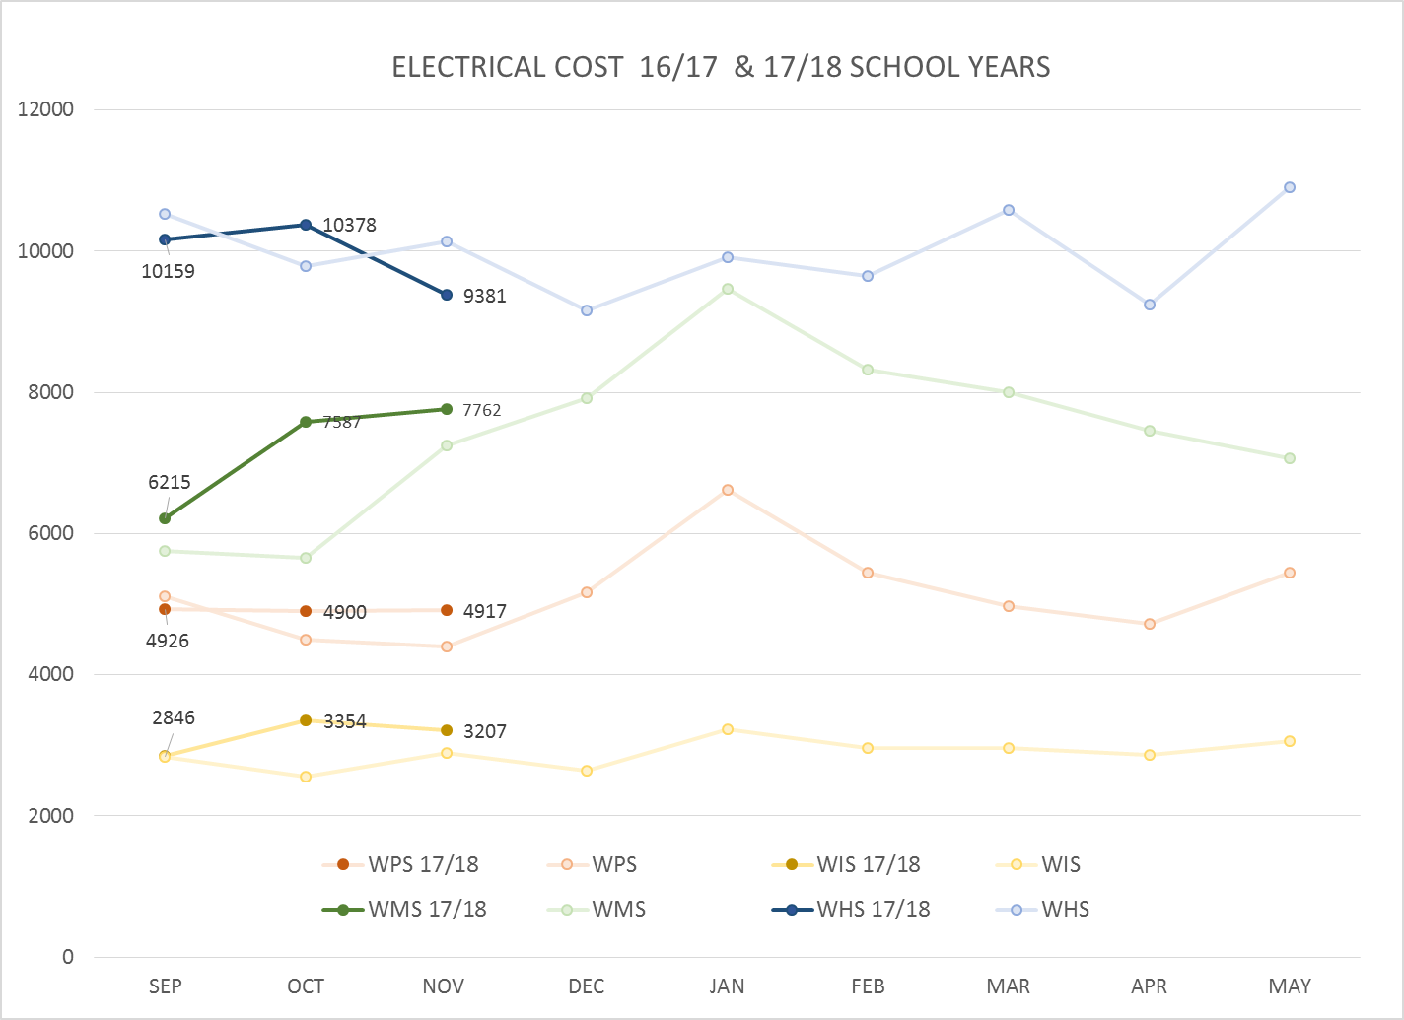
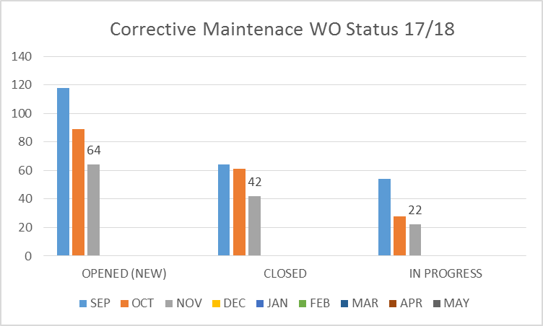
FACILITY CHARTS – POWER COST AND WORK ORDER STATUS

Slide 5
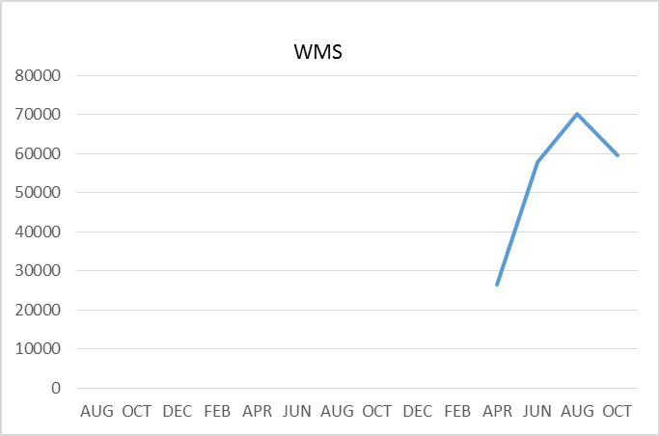
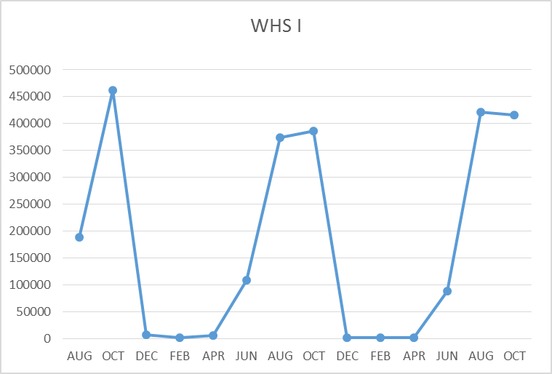
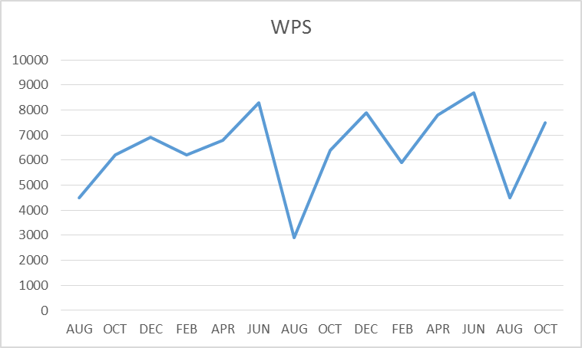
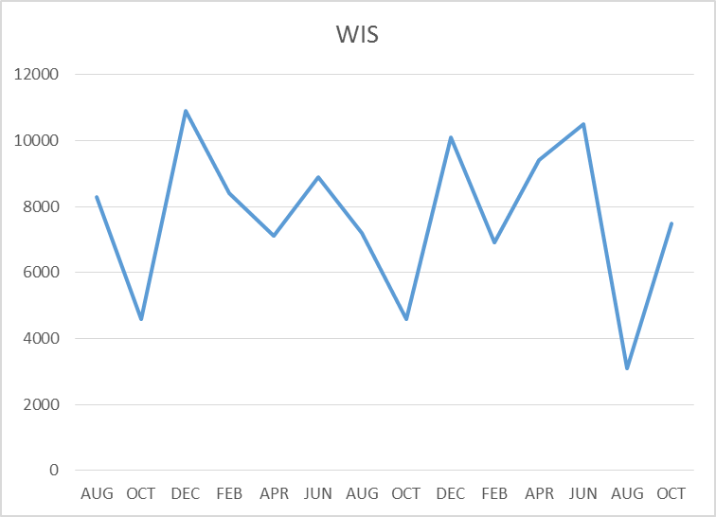
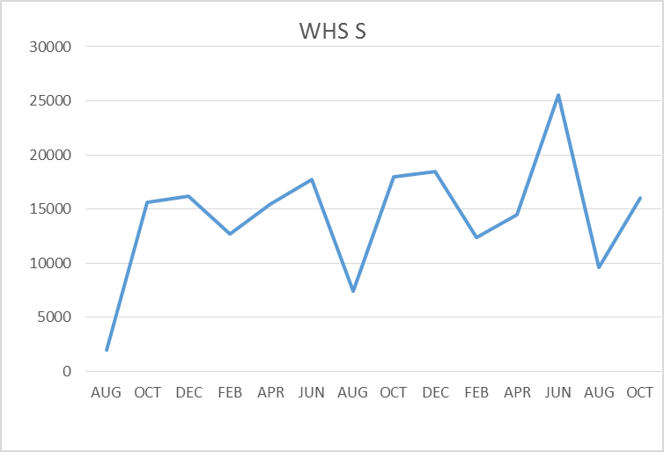
FACILITY CHARTS –
WATER USAGE
WHS, WIS, WMS, WPS
Water charts are updated every two
Months, next update to these charts
in January 2018
The WMS chart has been reconfigured to include the following 7 meters: 755 park high and low flow, BO and Team High, Pit house, buss barn, athletic field and DO. All of these meters are totaled on the WMS graph but each data point is recorded separately to aid in identifying leaks.

Slide 6
SAFETY REPORT
Accidents for the month
There were a total of 9 student injuries and 4 staff incidents/accidents
Staff Accidents/Incidents
WPS - Student behavior caused injury to IA (3 events)
Yale – One employee slipped on stairs
Student Accidents/Injuries (8)
WPS - Student pushed by another student injured rump
WIS – Student slipped on stair tread hit bottom
WIS - Student kicked ball lost footing and hit head on gym floor
WIS – Student slipped on portable ramp, scraped knee and hand
WIS – Closing blinds, student pulled to hard on rod and dislodged valance and struck arm
WHS – Students hair burnt by torch (careless handling)
WHS – Student rolled ankle during basketball, sprain
WHS – Students knee popped, fractured leg
WHS – Student missed bottom step, bruise and 2 minor abrasions

Slide 7
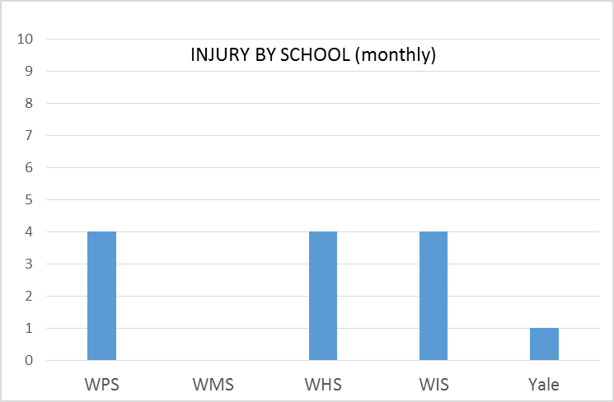
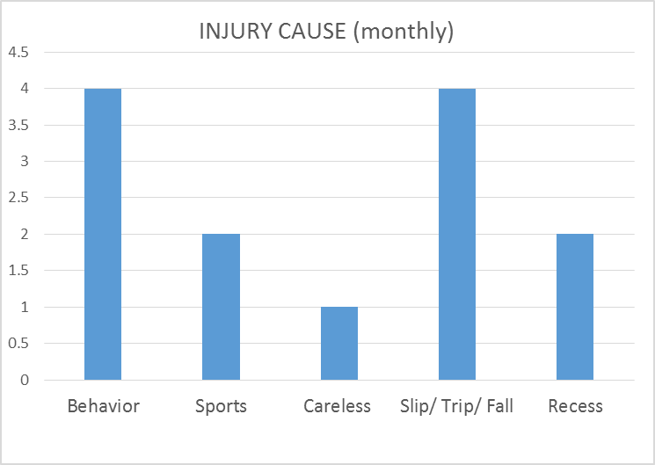
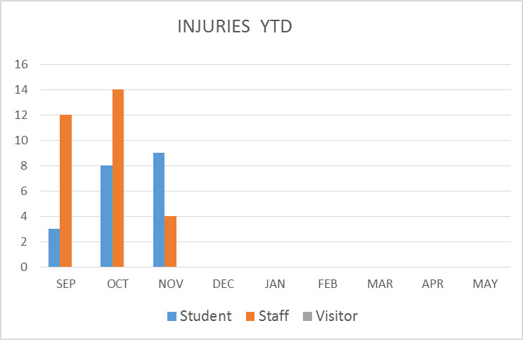
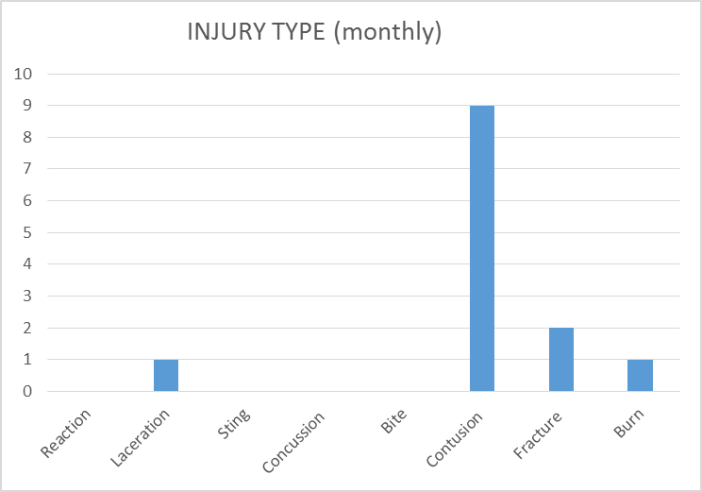
SAFETY CHARTS

